Slide 1
Operating System

Slide 2
Instructor
Name : Zaib Un Nisa
Email :
Office : AB2-001/2
Office Hours : 08:30 AM - 04:30 PM

Slide 3
Rules
– Raise your hand before asking any question and then WAIT for the permission
– Never miss a class
– Never sleep in the class
– Never use mobile phone
– Always communicate in the official communication language

Slide 4
Books
Operating Systems Concepts, by Abraham Silberschatz
Modern Operating Systems, 4th edition by Andrew S. Tanenbaum

Slide 5
Tentative Evaluation Break Down
Assignments(5) | 7.5
Quizzes(5) | 7.5
Presentation(1/2) | 10
Midterm | 25
Final | 50
Total | 100

Slide 6
Course Execution
3 Lectures Per Week
2 Lab Hours

Slide 7
Prerequisite For this Course
Data Structures and Algorithms

Slide 8
Course Outline
Operating systems basics, system calls, process concept and scheduling, inter-process communication, multithreaded programming, multithreading models, threading issues, process scheduling algorithms, thread scheduling, multiple-processor scheduling, synchronization, critical section, synchronization hardware, synchronization problems, deadlocks, detecting and recovering from deadlocks, memory management, swapping, contiguous memory allocation, segmentation & paging, virtual memory management, demand paging, thrashing, memory-mapped files, file systems, file concept, directory and disk structure, directory implementation, free space management, disk structure and scheduling, swap space management, system protection, virtual machines, operating system security

Slide 9
Computer System

Slide 10
Computer System
Hardware
Operating System
Application Program
User

Slide 11
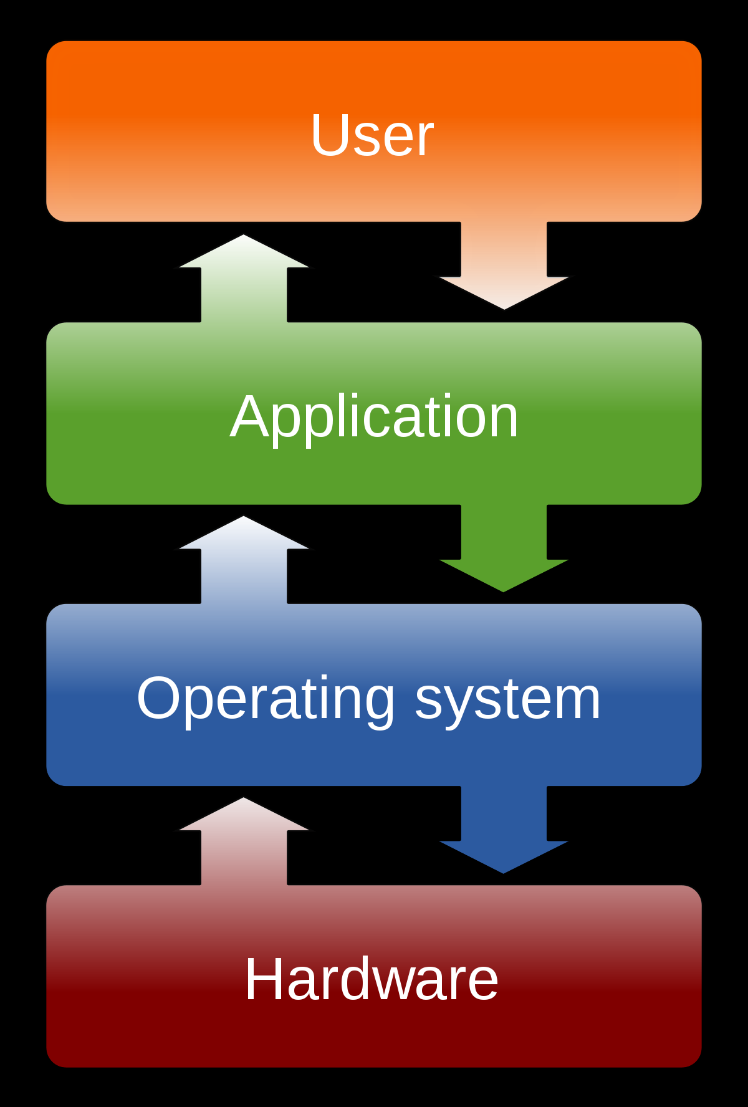
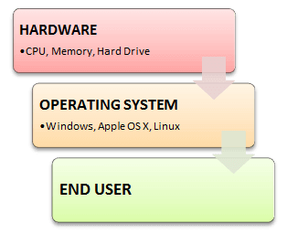

Slide 12
Purpose of Computer System
Computer systems consist of software and hardware that are combined to provide a tool to implement solutions for specific problems in an efficient manner to execute programs

Slide 13
Operating System
What is Operating System?
An operating system, or "OS," is software that communicates with the hardware and allows other programs to run
Every desktop computer, tablet, and smartphone includes an operating system that provides basic functionality for the device

Slide 14
Operating System
An OS is a layer of system software that
Directly has privileged access to underlying hardware
Hides the hardware complexity
Manages hardware on behalf of one or more applications according to some pre-defined polices
In addition it ensures that the applications are isolated and protected from one another

Slide 15
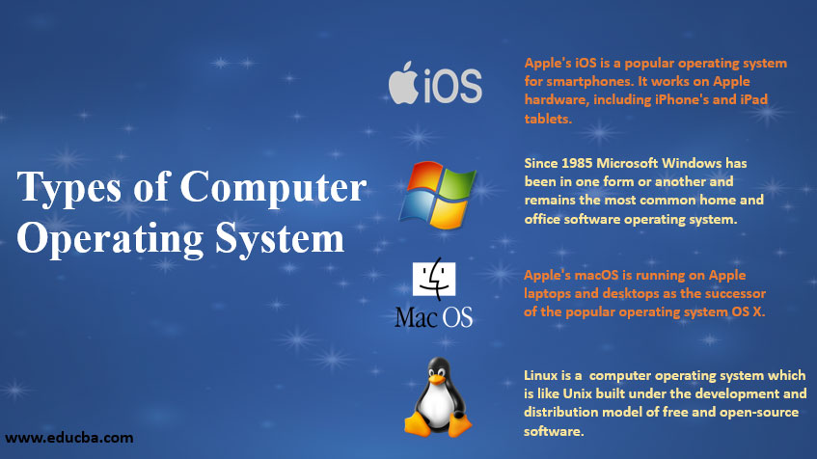

Slide 16
